Slide 1
Root Rot Management
David Rusch, Regional Forest Pathologist Cariboo and Thompson Okanagan David.Rusch@gov.bc.ca

Slide 2
Agenda
Office Session (8:30-10:30)
Field Session (10:30-end)
Place and Time to meet in field

Slide 3
Objectives
Increase the ability of people to recognize root disease in the field (hear no evil + see no evil ≠ no evil)
Promote Awareness of New Root Disease Management Guidebook
Discuss ways to improve root disease management by forest professionals (Disclaimer/Apology)

Slide 4
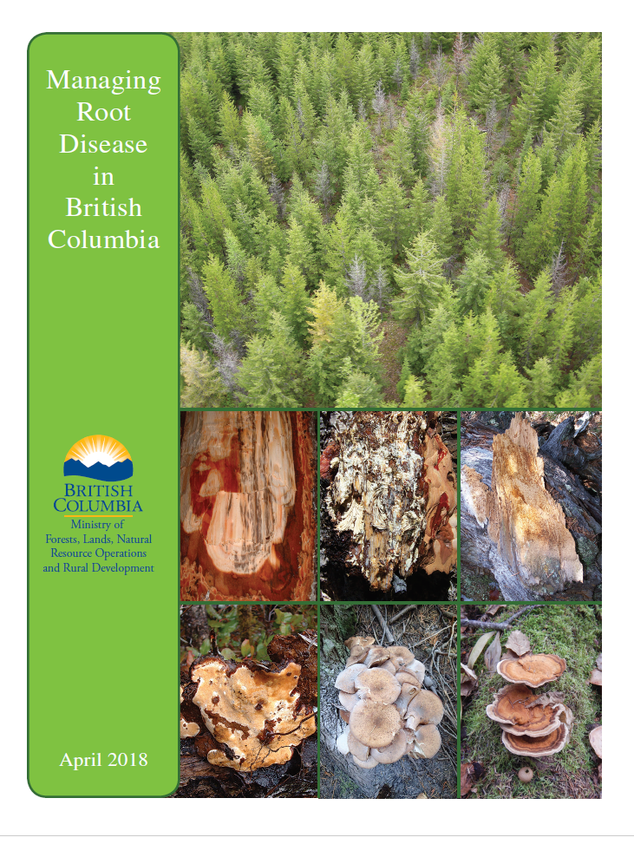
https://www2.gov.bc.ca/gov/content/industry/forestry/managing-our-forest-resources/forest-health/forest-pests/root-diseases

Slide 5
Why root disease management is important
Root disease can have a major impact on timber management and carbon sequestration
Timber Management practices often result in an increase in root disease over time
Volume based timber tenures result in a short term decrease in root rot free areas available for harvest (leave the worst for last)

Slide 6
Root diseases are diseases of the site
Spread slowly and persist in the same location for long periods of time on roots of dead trees or stumps or on live trees
Some root disease centers are very old hundreds if not thousands of years old
Natural components of ecosystems and likely important for many species of wildlife

Slide 7
timber harvesting affects on root disease
Timber Harvesting | No timber harvesting
Short regen delay period | long regen delay results in fewer available hosts (less host material)
Susceptible species planted often in close proximity to stumps | Root rot tolerant species favoured (less host material)
Trees are cut before trees fall over | Dead trees fall over removing large infected host material from the ground (fewer infected roots in ground)
Armillaria can spread rapidly through freshly cut stumps increasing the amount of infected roots in the ground | Live infected trees have defense mechanisms which slow the rate of spread
After harvesting Tomentosus moves from heartwood to sapwood in cut stumps (closer proximity to new roots) | Live trees keep Tomentosus confined more in the heartwood (less likely to encounter uninfected roots)
Fresh cut stumps increase the amount of exposed wood available for Heterobasidion spore infection | Much less exposed wood for spore infection of roots
Harvesting attracts secondary insects that vector black stain and reduces disturbance interval | longer times between major disturbance events keeps secondary insects in check

Slide 8
Major root diseases
1)Armillaria root disease (all tree species) DRA
2)Laminated root disease (affects all conifers except Cw but mostly associated with Fd) DRL
3)Tomentosus root disease (mostly associated with Sx but can affect Pl as well) DRT
4)Black Stain (pine and Fd varieties) DRB

Slide 9
Root Disease Management Process
Assess Hazard
Assess Risk (Root Disease Survey)
Weigh Management options against other resource values
Treatment
Plant Less Susceptible Species
Stump
Avoidance
Preharvest/ Timber Side
Post harvest/Silviculture Side

Slide 10
Assessing hazard
Assess hazard →BEC zone, climate, elevation, aspect, factors that favour growth of susceptible species or increase stress (eg. DRA on dry rocky south facing slopes)

Slide 11
Other available tools
Landscape level root rot information and or detailed root rot data base
Landscape level root rot mapping only works for root rot centers that are large and easily identified from the air but it can tell you where you are more likely to encounter root rot
Forest health strategies

Slide 12
Survey
Walkthrough or detailed survey (area or tree based)
Lidar or digital photography can help narrow down the survey area
End result should be some type of map showing root disease strata by level of root disease and species

Slide 13
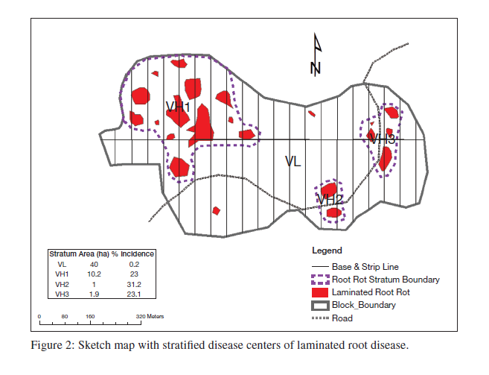

Slide 14
Most root rot treatment occurs during the post harvest/silviculture phase
reliant on good preharvest survey information collected during the timber layout/site plan phase
If proper root rot assessment is not part of the the timber layout/site plan phase effective root disease management is not possible → mitigation becomes only option (example throw in some less susceptible species across all your planting sites)

Slide 15
Problem
Detailed surveys can be expensive and there are a lack of good surveyors
Cruisers, layout crews, and site plan foresters often fail to recognize or document the presence of root disease

Slide 16
Solution
Better training and ability to recognize root disease signs and symptoms by all field staff
basic knowledge about root disease management and the implications of not collecting detailed information on the distribution and severity of root disease in the future

Slide 17
Treatment Options
i) Plant mixture of less susceptible species – Table 2 of root disease guide. Often a compromise between root rot susceptibility and most economic and ecologically suited species to site (eg. Cw is the least susceptible conifer species for both Armillaria and Laminated root disease but not widely planted because of ecological, timber, and climate change concerns)

Slide 18
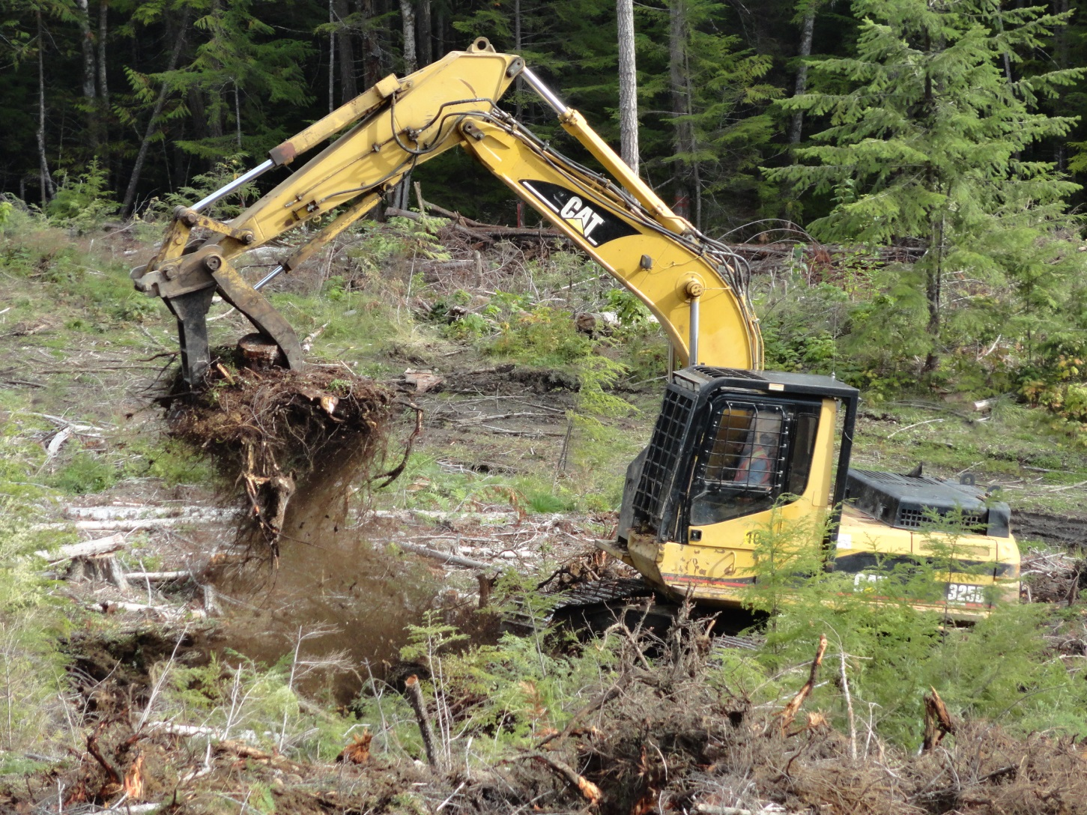
stumping

Slide 19
Stumping effectiveness
Most studies indicate that stumping is effective in reducing root rot levels and improving growth (mostly as a result of soil mixing) but doesn’t eliminate the problem
Stumpage allowances can offset the cost especially where site prep is required

Slide 20
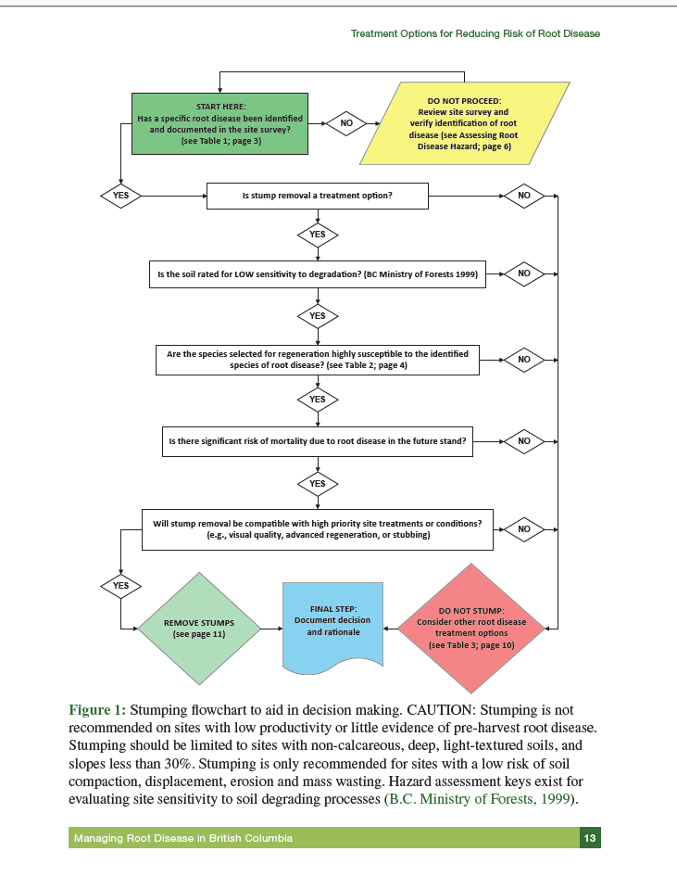

Slide 21
Limitations of stumping
Site factors (slope), soil factors (fine textured & shallow soils) and other resource values are the main factors that limit its use
Generally restricted to clearcuts
Many otherwise good forestry practices (eg. dispersed retention, hardwood retention, seed trees, wildlife trees, leaving advanced regeneration) will reduce the effectiveness of stumping

